Slide 1
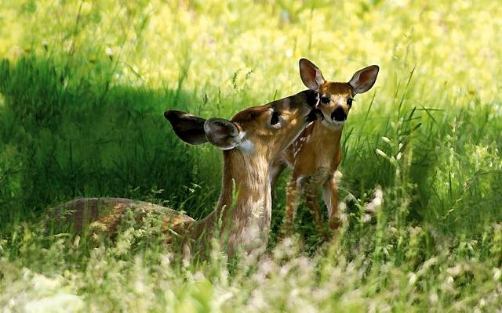
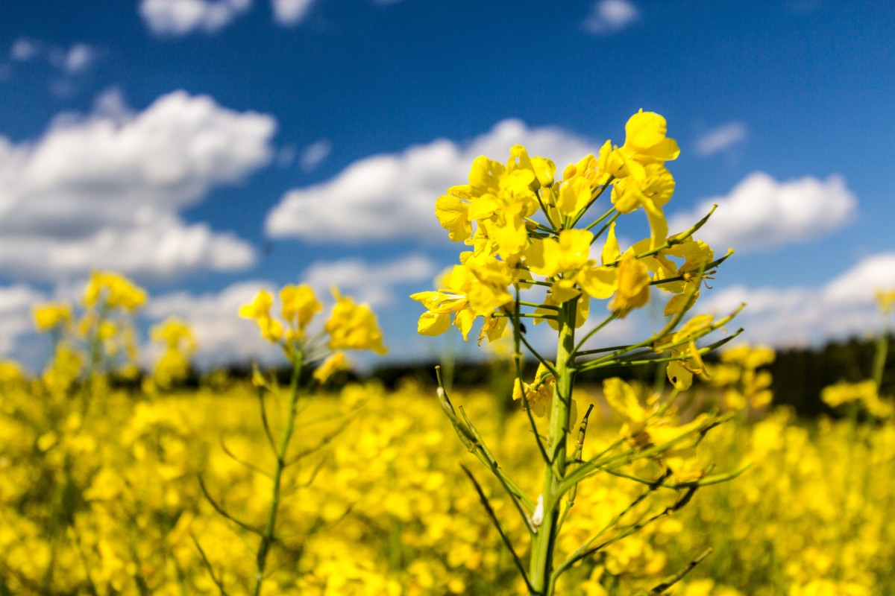
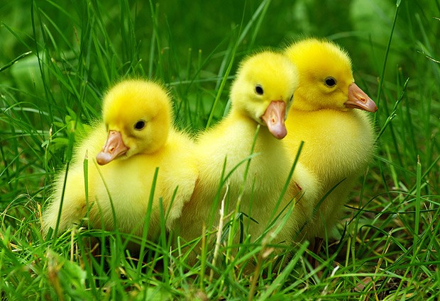

What’s up?!
Wie gehts?! Qué pasa?!
SPRING EDITION!

Slide 2
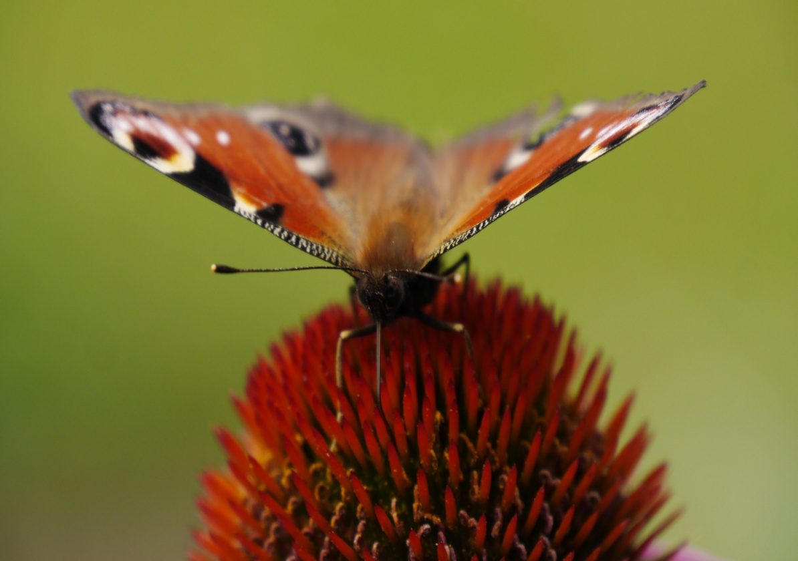

Frühling Gedichte
Spring Poems
rainbow – tęcza
snowdrop – przebiśnieg
sow – siać, zasiewać
spring break – przerwa wiosenna na studiach
spring cleaning – wiosenne porządki
sprout – młody pęd (rośliny), jadalny kiełek
start anew/ afresh – rozpocząć na nowo
sun-drenched – słoneczny
swallow – jaskółka
tadpole/ polliwog – kijanka
thaw – odwilż
tulip – tulipan
verdant – zielony
lark – skowronek
lush – bujny (o roślinności)
melt – roztapiać
mow the lawn – kosić trawnik

Slide 3


daisy – stokrotka
dandelion – mlecz (mniszek lekarski)
drizzle – mżawka
Easter – Wielkanoc
feel energized – czuć się pobudzonym
fertile – żyzny (np. gleba)
flourishing – w rozkwicie
fluffy clouds – puszyste chmurki
go barefoot – chodzić na boso
grasshopper – konik polny
grassy – trawiasty
green pasture – zielone pastwisko
hatch – wykluwać się (z jajka)
joy – radość
ladybird – biedronka
puddle – kałuża
pansy – bratek

Slide 4

awakening – przebudzenie
bask – wygrzewać się (np. na słońcu)
beetles – żuki
blooming – kwitnący
blossoming – zakwitanie
breezy – wietrzny
bright – słoneczny (np. dzień)
bud – pąk, pączek (np. kwiatu)
bulb – bulwa (roślina cebulkowa)
bunny – króliczek
butterfly – motyl
buzz – bzyczeć (np. pszczoła)
catkins – bazie
cheerful – radosny (np. człowiek)
chirp – ćwierkanie
cress – rzeżucha
crisp mornings – rześkie poranki
crops – uprawy

Slide 5

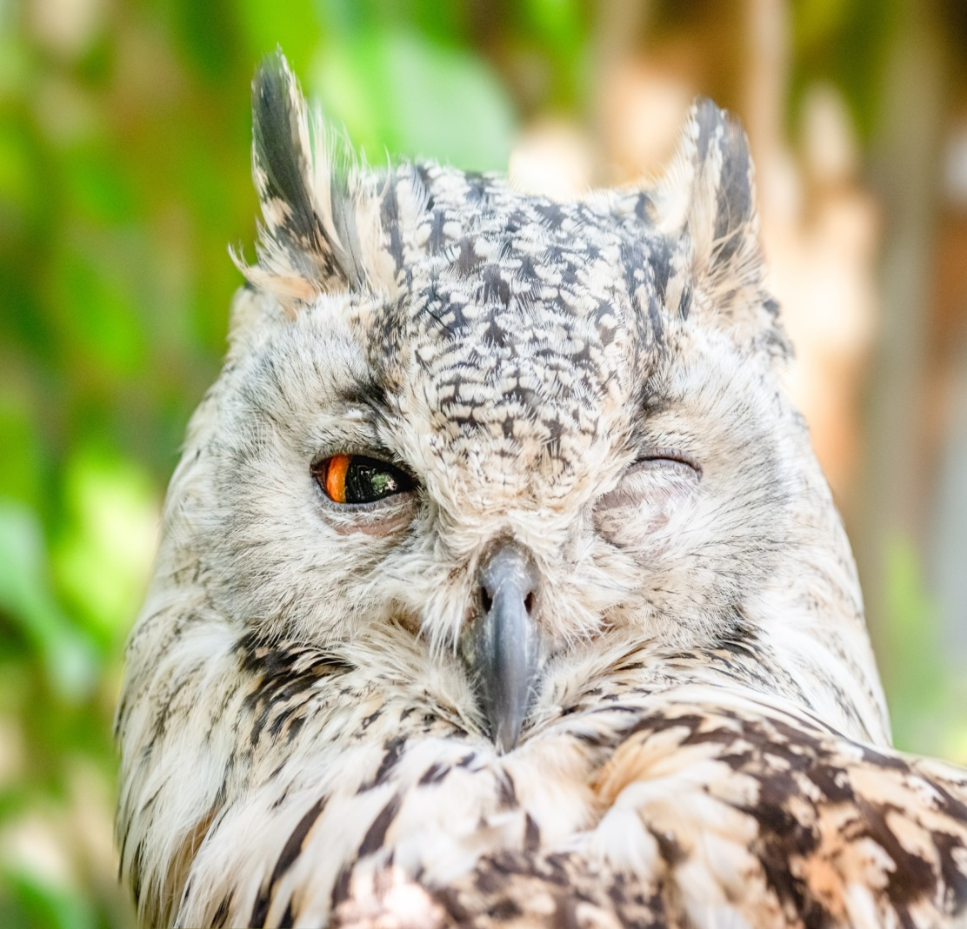
Spring Vocabulary!
,,Spring”
Spring is here,
let’s give some cheer!
Flowers bloom,
I blow balloons.
The kids play,
Say hooray!
Spring is today.
„What the robin told”
The wind told the grasses,
And the grasses told the trees.
The trees told the bushes,
And the bushes told the bees.
The bees told the robin,
And the robin
sang out clear: Wake up! Wake up!
Spring is here!

Slide 6


„Spring from my window”
Spring from my window.
I can see…
It’s sunny, it’s sunny.
It’s perfect for me!
I can smell the flowers.
I can see the colors. And…
What’s the big bird
in the sky ?
It’s a stork!
Black and white.
Spring from my window.
I can see …
It’s sunny, it’s sunny.
It’s perfect for me !
Julia 1B
What is your favourite subject and why?
I think it is biology, that is why I chose this field of study. Biology is an interesting subject for me and I learn it easily.
How do you feel in the new school?
I feel very good. The atmosphere is friendly. Everyone is very nice and polite.
What was your first day in high school like? Describe it more or less.
The lessons started at 8:50 am. It was German. I really appreciate the lessons of this language very much. My class is nice. Everybody is nice. From the very first day, I liked subjects and teachers. Some teachers are very demanding, but I think sewing in will be fine.

Slide 7


Oskar 1G
Tell me something about yourself. Describe yourself or tell me what you are.
I am a man who appreciates the properly arranged values in the hierarchy. I like honesty and loyalty. I do my best and achieve my goals. I think I am very ambitious.
How would you describe your personality.
I have an explosive temperament, but I try to minimize it. Whenever it is necessary, I help everyone.
What is your attitude towards teachers and do you like them?
In my opinion the teachers who teach me are very good. I'm glad I found them. I tried not to upset the teachers. I think they really liked me.

Slide 8


At the very beginning of the school year, we interviewed the first graders. Here it is:
Aleksandra 1L
List your three strengths.
It is definitely loyalty. I am a person
who can talk about any topic. I'm not
afraid of talking about controversial
things. Whenever I do something from
the heart, I give 110% of myself.
What were your thinking about before going
to our school?
I was wondering how others would perceive me.
Why did you choose this direction and who do you want to become in the future?
I chose linguistics because I liked the languages and the entire department. I don't know who I want to be in the future, that's why I chose the language course.
8
8

Slide 9

Daria 1L
What do you like doing when you aren’t at school? What are your interests?
Most of all, I like baking and cooking. I have been learning Korean for a year. Very interested in Asian culture. I like reading psychological and criminal books.
Which school subject do you like the least and why?
I like chemistry the least. The teacher is very nice and demanding, but the subject itself scares me.
Why did you choose this school and what did you like about it?
First of all, my intuition told me that I had to go to this school to achieve what I wanted. The school is well developed. I think that thanks to it and my hard work, I can achieve my goals.
Well, but what do you like about the school.
I like the fact that teachers are not indifferent to students. They treat us like adults. I think the headmistress wants the best for everyone. I also like the nice atmosphere and the people at school.
„Spring is Coming”
Spring is coming, spring is coming.
How do you think I know?
I see a flower blooming,
I know it must be so.
Spring is coming, spring is coming,
How do you think I know?
I see a blossom on the tree,
I know it must be so.
„Spring”
Spring, Spring,
Springtime is here!
Grass is green,
and flowers grow.
Birds are singing.
Bees are buzzing!
Kites are flying everywhere.
Spring, spring,
Springtime is here!
12
9

Slide 10

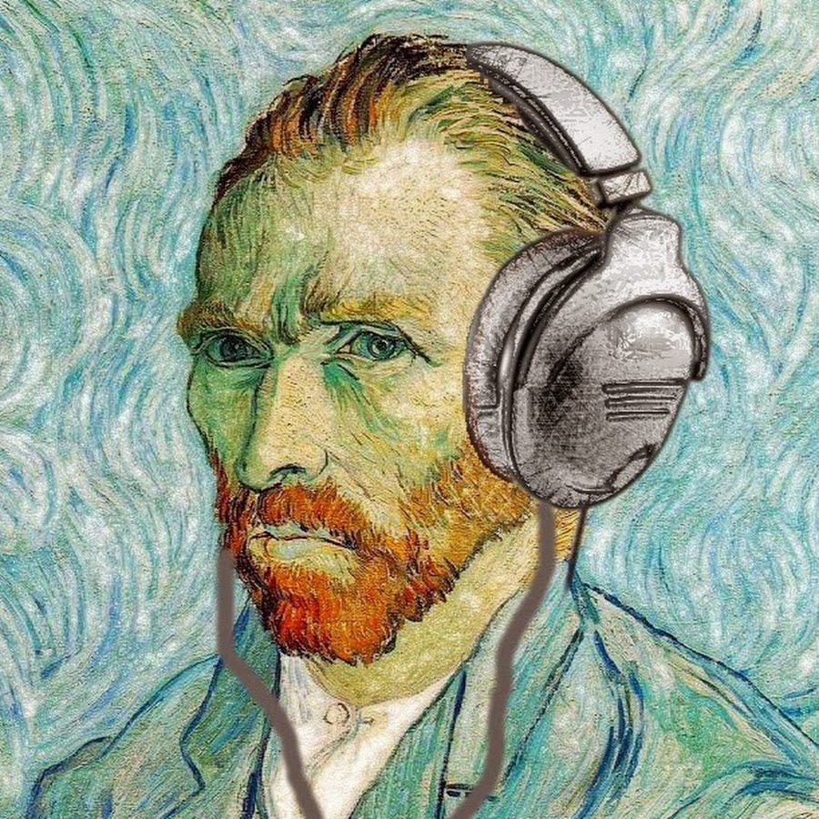
Interview

Slide 11
